Slide 1
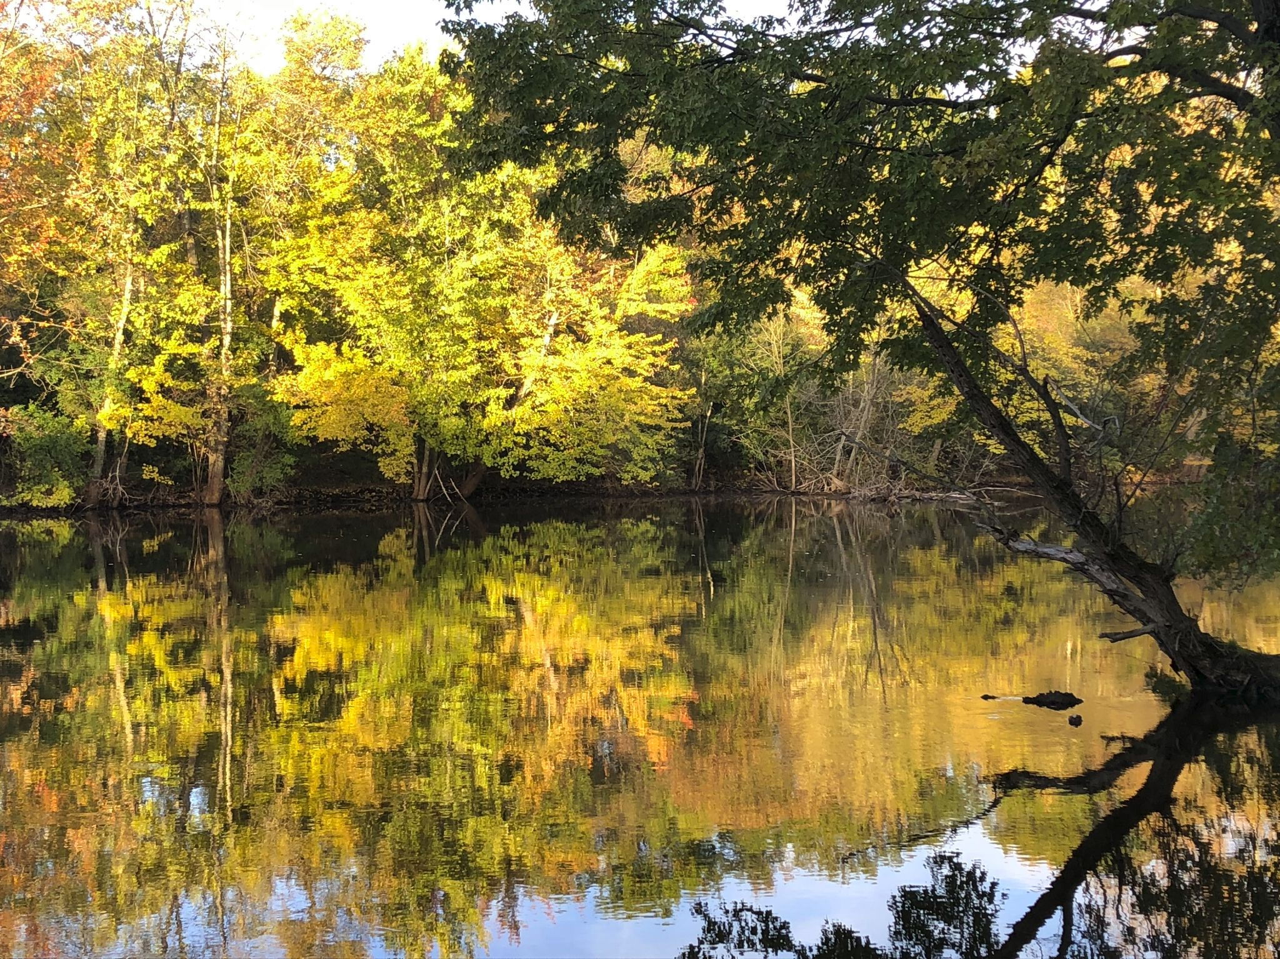
How Can We Help the Water Bugs?
Notes:
Teacher Talk: Water bugs are important for streams, lakes and rivers. People’s actions on land can affect them. Let’s see how.
Note for Teacher:: It helps the HRWC to have data on student’s pre and post understanding about the watershed. Please consider asking your students to fill out these polls.
Pre-Poll students:
https://forms.gle/YP8Zqw9FC919s3dg8
How do you know if a river is healthy?
Why is it important for rivers and streams to be healthy?
What do people do that make rivers unhealthy?

Slide 2
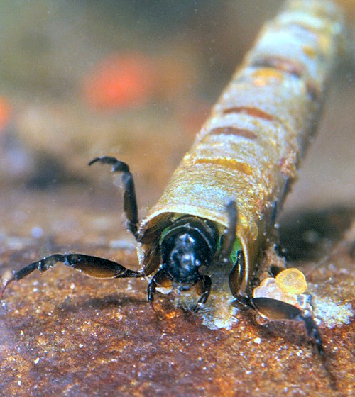
Which bugs are we talking about?
Many small creatures live in the water for part or all of their life cycle.They are an important part of many food chains. And they can be indicators of water quality.
Watch one or both of these videos to learn a little more.
https://www.youtube.com/watch?v=ReCOnps2jeI
Stop at minute 6 if you prefer
https://www.youtube.com/watch?v=Z2CkD4sa9SI
Notes:
Note for Teacher: We suggest reviewing both videos to see which better suits you and your students.

Slide 3
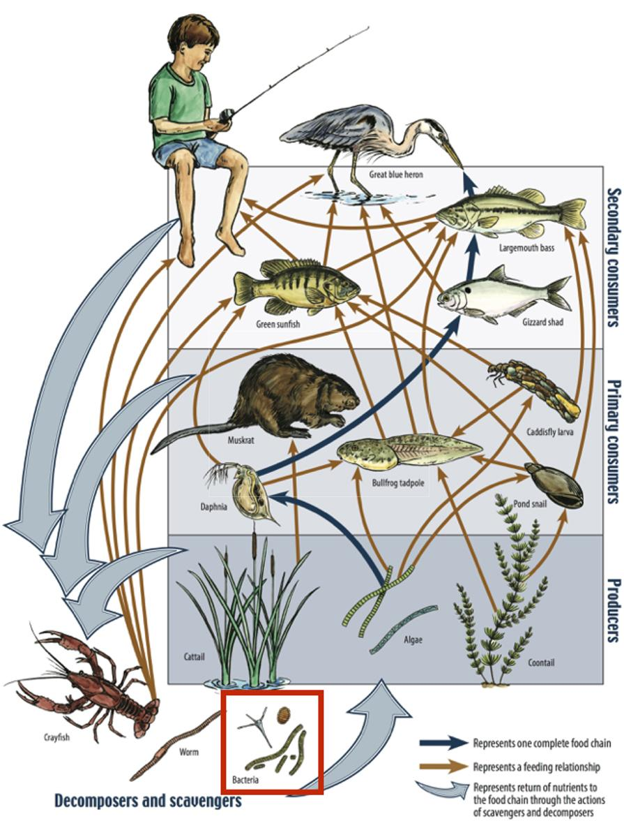
Kestin Schulz, Mariya W. Smit, Lydie Herfort and Holly M. Simon. The image (amended) was provided courtesy of the Missouri Department of Conservation., CC BY-SA 4.0
Notes:
Teacher Talk: Example of an aquatic food web: Bacteria can be seen in the red box at the bottom. Bacteria (and other decomposers, like worms) decompose and recycle nutrients back to the habitat, which is shown by the light blue arrows. Without bacteria, the rest of the food web would starve, because there would not be enough nutrients for the animals higher up in the food web. The dark orange arrows show how some animals consume others in the food web. For example, lobsters may be eaten by humans. The dark blue arrows represent one complete food chain, beginning with the consumption of algae by the “water flea” Daphnia and Caddisfly larvae, which are consumed by a small fish, which is consumed by a larger fish, which is at the end consumed by the Great blue heron. Credit: Wikipedia https://commons.wikimedia.org/wiki/File:Aquatic_food_web.jpg#/media/File:Aquatic_food_web.jpg

Slide 4
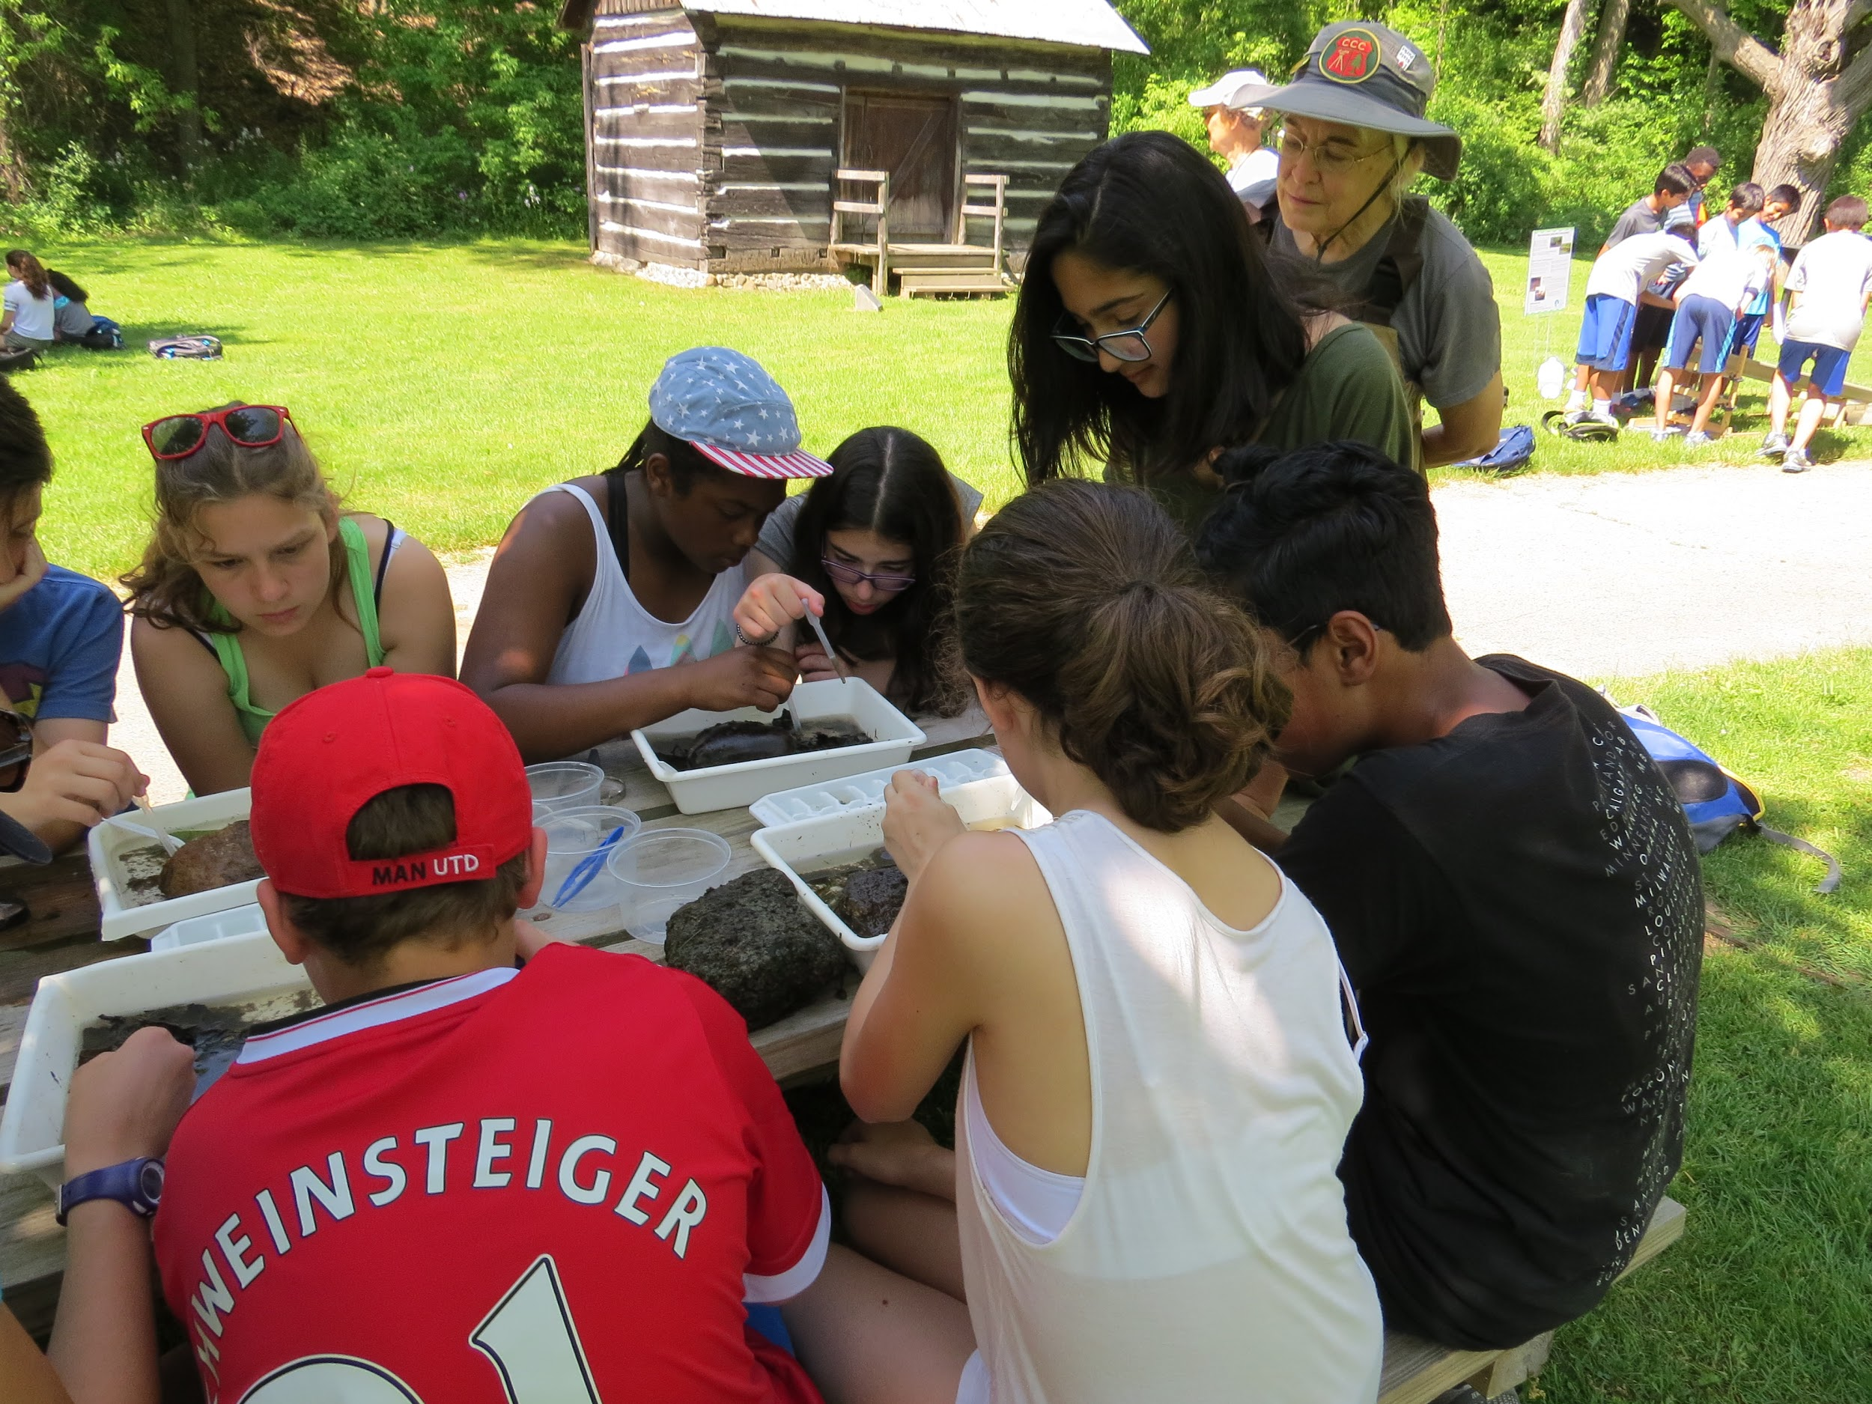
Benthic Macroinvertebrate diversity indicates water quality because the bugs are affected by the conditions of the water they live in.
The Huron River Watershed Council measures Benthic Macroinvertebrate numbers to assess the health of our watershed (all the land that drains to the Huron River).
This slide show will be analyzing 3 factors that may impact water quality health and benthic macroinvertebrates: sediments in the water, dissolved oxygen, and conductivity.
Notes:
Teacher Talk: Species diversity is an important idea in Ecology. The big idea is that having a variety of species in a given ecosystem supports the stability of that ecosystem. It is less fragile in the face of changes such as floods, drought, invasive species and other ecosystem challenges.
The Huron River Watershed Council uses measurements of benthic macroinvertebrates as indicators of watershed health -- the greater the diversity of bugs, the healthier the water quality. HRWC measures many water quality parameters that can impact bug diversity. Because the aquatic insects need the right conditions for their whole lives, these bug measurements are a stronger indicator than just sampling the water at one point one time.
Note for Teacher: This slide deck presents 3 factors that affect species diversity and health: Sediments in the Water, Dissolved Oxygen and Conductivity. Of course there are other factors that can affect species diversity and population numbers.

Slide 5
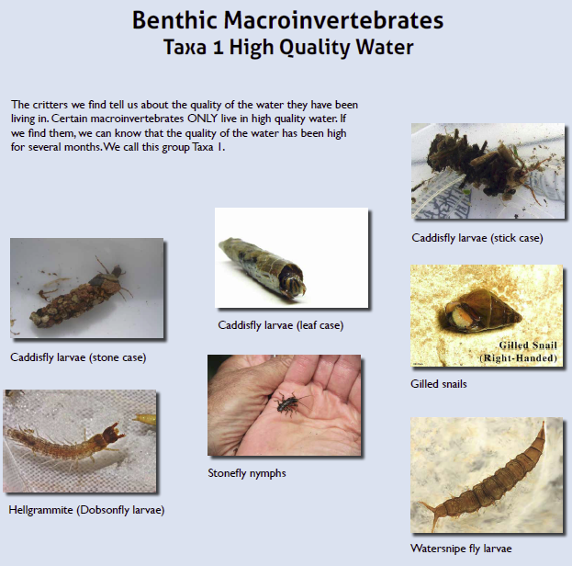
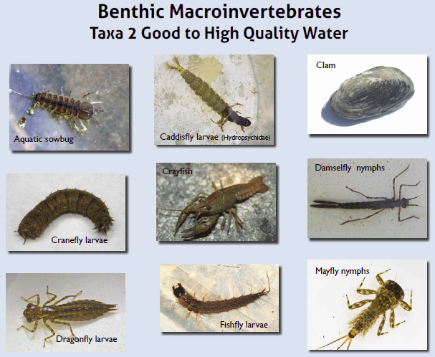
Notes:
Teacher Talk: HRWC collects data on sensitive families of macroinvertebrates. Families is a form of classification (like genus and species). Sensitive means that these animals cannot live in polluted or low-quality water. We call these sensitive families Taxa 1 and Taxa 2. So when these sensitive individuals are found, they indicate that water is of high quality. It’s not enough to find just one individual, though. A strong food web has a diversity, or variety, or species. This diversity helps the food web stay stable. So finding a variety of sensitive species means that the water quality has been good over time.

Slide 6
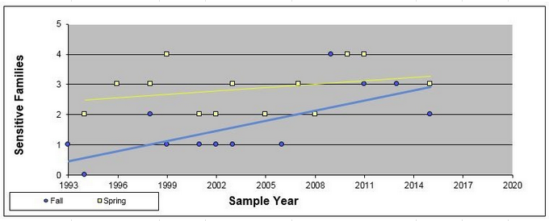
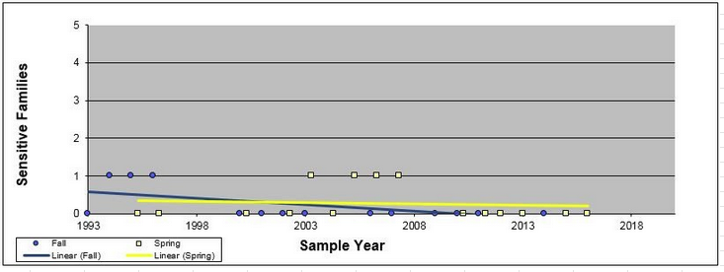
How does the diversity of aquatic insects compare in these two creeks?
Fleming Creek →
← Millers Creek
Notes:
These questions can be found on the “How Can We Help the Water Bugs Student Page” on-line.
***Add hyperlink here
Maps of the watershed showing the location of these two creeks can be found on slides 31 and 32.
Student page question 1. In slide 6, describe what the two graphs represent.
KEY: The graphs show the numbers of sensitive families of insects over time at 2 creeks.
Student page question 2. How does the diversity of aquatic insects compare in the two graphs?
KEY: For Fleming Creek It appears that the number of sensitive families is increasing for spring sampling, holding steady for fall sampling. For Millers Creek it appears that the number of sensitive families is holding steady for spring sampling and decreasing for fall sampling. Fleming Creek has more sensitive families compared to Millers Creek.
Student page question 3. The diversity of aquatic insects is used as an “indicator” for watershed health. Why do you think that is a stronger indicator than just taking a water sample?
KEY: A water sample only shows what the water is like for 1 moment in time. For sensitive insect families, the water quality has to be good during the entire life of the insect, and their parents, grandparents, etc. So if they are present, they are a strong indicator of the history of the water quality.

Slide 7
People’s actions on land can affect bugs in the water
Notes:
Teacher Talk: Turbidity means dirt in the water. The students are looking through a turbidity tube to measure dirt in the water.
Student page question 4. Name at least 3 ways excess sediments in the water can affect the river.
KEY Dirt makes it hard for BMI to attach themselves. Dirt fills in the spaces in the gravel, harming the habitat and spawning areas. Dirt hurts gills. Dirt clouds the water. Dirt in water can absorb heat, raising the water temperature and leading to lower dissolved oxygen.

Slide 8
Notes:
Student page question 5. Tell at least 2 ways excess sediments get in the river.
KEY: Rain events wash dirt into the river. Mowed edges let sediment through. Without protection such as plastic baffles (silt fences), exposed soil at construction projects may let the dirt move farther.

Slide 9
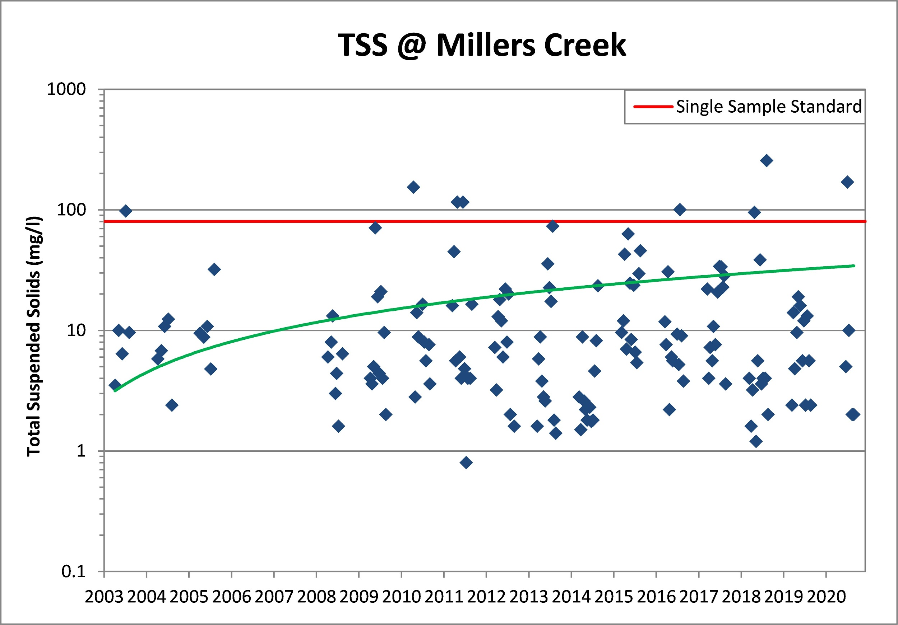
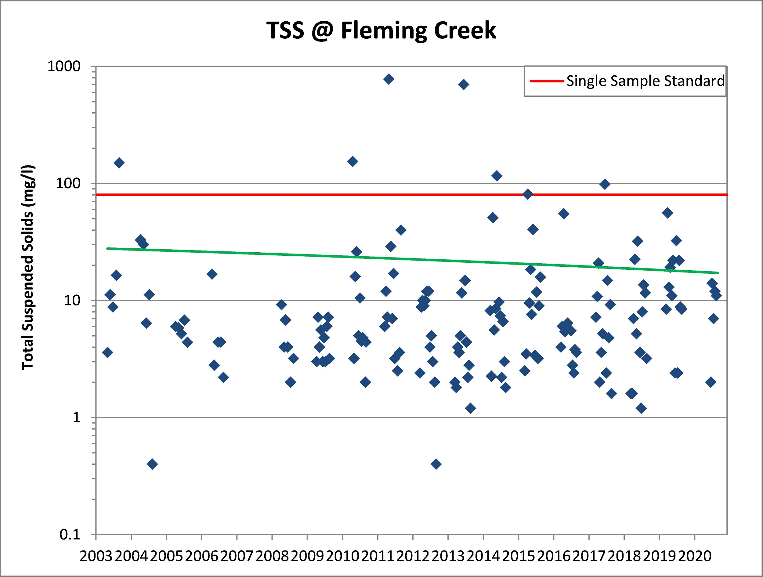
Turbidity (AKA dirt in the water) can be measured by Total Suspended Solids (TSS) A high TSS indicates high turbidity and erosion problems.
The green line is the trend line. What does it show?
Millers Creek’s mean TSS is 18.33 mg/l, although during high flow TSS levels can reach up to 256 mg/l.
Fleming Creek’s mean TSS is 25.6 mg/l.
Notes:
Teacher Talk: These graphs are scatter plots. The green lines are trend lines and indicate the general pattern of the data over time. The red lines are the state standard for healthy water.
Student page question 6. On the TSS graphs for Fleming and Miller creeks, what do the green trend lines show for each creek?
KEY: For Millers Creek there is an increase in dirt in the water. For Fleming Creek there is a small decrease.

Slide 10
Stream flow is an important underlying factor for determining likely erosion rates, stream habitat quality, and aquatic community diversity. An important measure is “flashiness” or the rate a stream rises and falls through a storm event.
Fleming Creek has a flashiness rating that is high for comparable Michigan streams, but average for the Midwest.
Millers Creek is extremely flashy. Recent projects have reduced the flashiness considerably, though a serious problem still exists.
Notes:
Teacher Talk: Ask Students to make a statement of how the flashiness compares between the two creeks. Then ask how they THINK flashiness and TSS could be related.
Notes to teacher: Here are two videos of a “flashy stream”
Water flow directly after a rain event is very high: https://hrwc.sharepoint.com/:v:/g/proj/adopt/EfmfgWJ1bU5KobWTM5QNUgsBl7LLhC74NZ2m26g63i5skg?e=UVYx64
Three days later, nearly no water flow: https://hrwc.sharepoint.com/:v:/g/proj/adopt/EQB3gwl3aatLvTdne-xS_QEBf4X_ZPCXMomnShoFv4hBCg?e=Qmfaec
Student page question 7. How is stream “flashiness” connected to TSS?
KEY: Flashiness is connected to TSS because fast moving water can move more dirt. When a rain event occurs, an area with more pavement and roofs experiences a faster transfer of storm water into the storm sewers and then to the creeks.

Slide 11
Impervious surfaces
Are surfaces where rain runs off, instead of soaking into the ground,
such as roofs, roads, parking lots, and sidewalks. Stream Flow is highly impacted by the amount of nearby Impervious Surfaces.
Numerous studies have shown that fish and insect communities are less diverse when the amount of impervious surface exceeds 10-12% of the total watershed area.
Fleming Creek
Since 11% of the Fleming creekshed is currently impervious, this means that the system is at the tipping point of losing much of its biological diversity.
Millers Creek
Since 30% of the Millers creekshed is currently impervious, this means that the system is has lost much of its biological diversity.
Notes:
Teacher Talk: Ask the students to give reasons why impervious surfaces such as pavement and roofs might affect species diversity.
(Impervious surfaces increase the impact of stormwater runoff. Impervious surfaces can cause “flashiness in creeks”. Stormwater runoff affects stream erosion and thus stream temperature and dissolved oxygen.)

Slide 12
Turbidity
Which creek is healthier in terms of turbidity?
Type your claim here:
Type two pieces of evidence here:
Explain why the evidence supports your claim:
Notes:
Student page question 8:
The research question is provided.
Develop and write a claim (one sentence answer to the research question) in the appropriate place in the graphic organizer.
Identify two pieces of evidence from the data provided that support the claim and type them into the appropriate place.
HINT: try to use quantitative data as part of the evidence
Write two bullet points describing the science that explains why the evidence supports the claim.
HINT: stay focused on the research question

Slide 13
Notes:
Teacher Talk: Ask students to think of additional ways people can reduce runoff or keep sediments out of the river. Examples could include not hosing down driveways or not washing cars on driveways, reducing grass lawns by planting bushes or native plants in their yards, using rain barrels, using erosion barriers for home improvement projects.
Student page question 9. Tell at least 2 ways people can keep sediments out of the river.
KEY: not hosing down driveways or washing cars on driveways, reducing grass lawns by planting bushes or native plants in their yards, using rain barrels. Install erosion barriers at construction sites, home improvement projects, make rain gardens, don’t mow to stream edges, plant trees and bushes, Use less concrete.

Slide 14
Dissolved oxygen (DO)
is the amount of oxygen that is present in water.
Notes:
Teacher Talk: Ask students how they get oxygen. (Breathe in air to their lungs) Ask what do their bodies do with the oxygen once they get it. (Dissolve it into their bloodstream, use it to burn food for energy.) Explain that fish and other water dwellers also need oxygen. Many of them use gills to collect dissolved oxygen from the water. There is far less oxygen in the water than in the air, so any reduction in DO can have bad impacts on the gilled animals.
Student page question 10. Which of the listed animals are most able to survive in low oxygen waters?
KEY: Mosquito larvae, carp, catfish.

Slide 15
Notes:
Teacher talk: Shallow, turbulent water like rapids can dissolve more oxygen into streams. This is different than the fast-moving pulses of water following storm events that cause erosion and move lots of dirt as discussed in the section on Turbidity.

Slide 16
Notes:
Student page question 11.
Describe the trend shown in this graph.
KEY: As the temperature increases, the amount of DO decreases.
Question 12. How do you think a decrease in dissolved oxygen might affect benthic macroinvertebrates?
KEY: As the DO decreases, fewer of them would be able to stay alive.

Slide 17
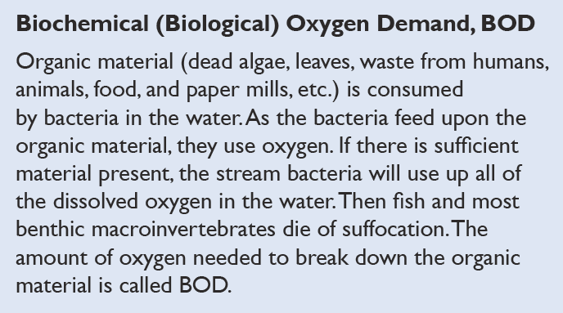
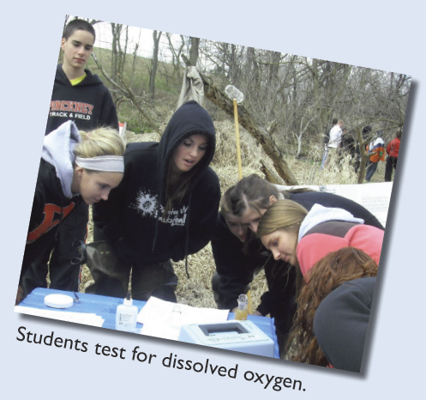
Notes:
Student page question 13. List 2 factors that can influence dissolved oxygen in streams and rivers and explain how one of them works.
KEY: Temperature, Stream Speed, BOD. Temperature - the warmer the water, the less oxygen it can hold. Shallow water or water with more dirt in it heats up more quickly than deep water or clean water. Stream Speed - Water that is more turbulent (tumbling around, as in a rapid) has more surface area touching the air so it can dissolve more oxygen into it. BOD - Bacteria decomposing organic material in the water requires oxygen.

Slide 18
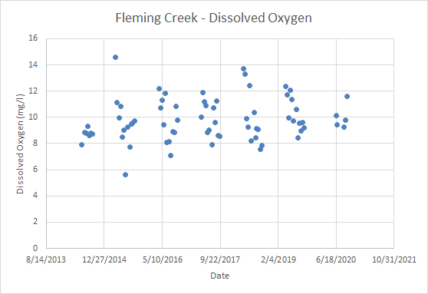
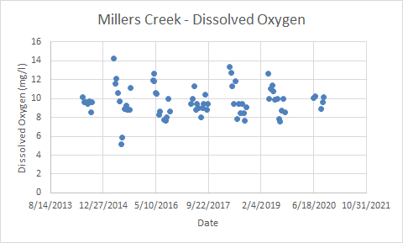
Graphs comparing DO in Fleming and Millers Creek
Notes:
Student page question 14
Which Creek is Healthier in Terms of Dissolved Oxygen?
There is no apparent difference in DO between these two creeks.
Identify two pieces of evidence from the data provided that support the claim.
The measured DO samples fall between 6 and 14 on both graphs. While not statistically significant, trends in DO values at Fleming Creek appear to be slightly increasing. While all measured dissolved oxygen concentrations were above the state standard, there are no apparent trends in dissolved oxygen at Millers Creek.
Write two bullet points describing the science that explains or predicts why the evidence supports the claim.
Because the evidence is similar in both cases, we cannot make a claim that one creek is healthier than the other.

Slide 19
What Makes a Healthy Creek?
A healthy creekshed has stable banks with a broad corridor of trees and shrubs, riffles free of silt deposition, fairly stable temperatures and a benthic population that includes a diverse variety of creatures, including several groups that are sensitive to organic pollution.
Dissolved oxygen at Fleming Creek, as measured by HRWC’s Chemistry and Flow Monitoring Program, is consistently above the state standard of 5 mg/l with measured values ranging from 5.64 to 14.59 mg/l. Dissolved oxygen measured at Fleming Creek between 2014 and 2019 averaged 9.77 mg/l (s=1.6) with a median of 9.48 mg/l. While not statistically significant, trends in DO values at Fleming Creek appear to be slightly increasing.
Dissolved oxygen at Millers Creek, as measured bimonthly by HRWC’s Chemistry and Flow Monitoring Program, is consistently above the state standard of 5 mg/l with measured values ranging from 5.2 to 14.59 mg/l. Between 2014 and 2019, dissolved oxygen measured at Millers Creek averaged 9.70 mg/l (s=1.66) with a median of 9.45 mg/l. While all measured dissolved oxygen concentrations were above the state standard, there are no apparent trends in dissolved oxygen at Millers Creek.
Notes:
Teacher Talk: Here is more information on how Dissolved Oxygen is represented in Fleming and Millers creeks.
Student page question 14. Use the data from the graphs and the information in slide 18 to fill out the Claim/Evidence/Reasoning graphic organizer.
Which Creek is Healthier in Terms of Dissolved Oxygen?
There is no apparent difference in DO between these two creeks.
Identify two pieces of evidence from the data provided that support the claim.
The measured DO samples fall between 6 and 14 on both graphs. While not statistically significant, trends in DO values at Fleming Creek appear to be slightly increasing. While all measured dissolved oxygen concentrations were above the state standard, there are no apparent trends in dissolved oxygen at Millers Creek.
Write two bullet points describing the science that explains or predicts why the evidence supports the claim.
Because the evidence is similar in both cases, we cannot make a claim that one creek is healthier than the other.

Slide 20
Dissolved Oxygen
Which creek is healthier in terms of dissolved oxygen?
Type your claim here:
Type two pieces of evidence here:
Explain why the evidence supports your claim:
Notes:
Student page question 14.
The research question is provided.
Develop and write a claim in the appropriate place in the graphic organizer. There is no apparent difference in DO between these two creeks.
Identify two pieces of evidence from the data provided that support the claim and type them into the appropriate place.
The measured DO samples fall between 6 and 14 on both graphs. While not statistically significant, trends in DO values at Fleming Creek appear to be slightly increasing. While all measured dissolved oxygen concentrations were above the state standard, there are no apparent trends in dissolved oxygen at Millers Creek.
Write two bullet points describing the science that explains why the evidence supports the claim.
Because the evidence is similar in both cases, we cannot make a claim that one creek is healthier than the other.

Slide 21
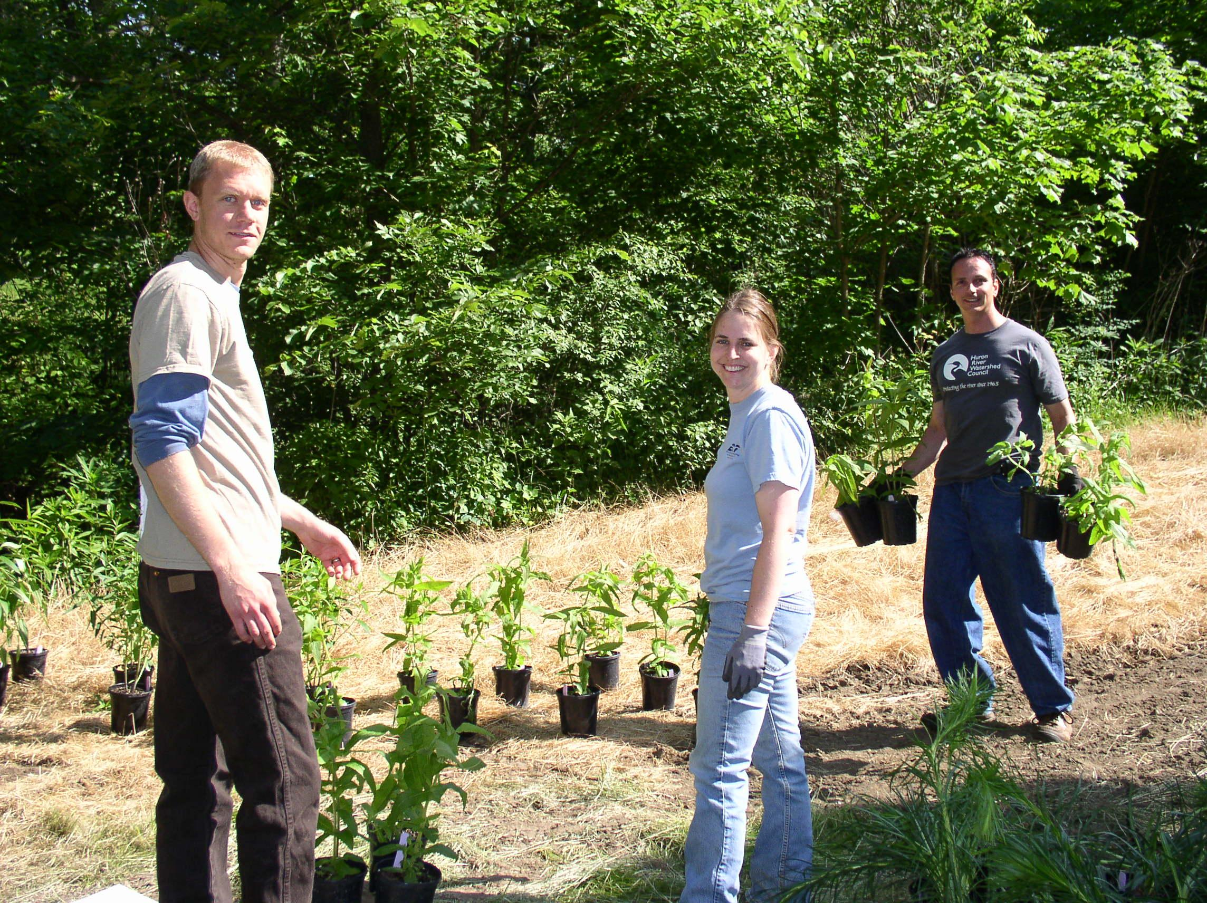
How can people improve the amount of dissolved oxygen in the water?
Plant trees for shade
Pick up dog poop
Keep sediments on your property: don’t sweep or spray dirt into the gutter
Plant rain gardens
Notes:
Student page question 15. Choose one of the suggested actions on Slide 25 and tell how it would work to improve DO in a stream.
KEY: Shade, whether over land or water is cooler than not shade. So rain falling on shade would run off cooler than rain falling on unshaded land.
Dog poop when carried by runoff to a stream, gets decomposed by bacteria. Bacteria use oxygen to live, so they use up DO in the stream.
Dirt gets carried to streams by runoff. It causes water to heat up faster when the sun is shining on dirty water.
Rain gardens slow hot rain water from running into the river too quickly.

Slide 22
Conductivity is a quick and easy measurement to make, and is useful as an indicator of numerous potential problems. Conductivity measures the ability of a water sample to conduct electricity. The presence of dissolved ions in water allows it to conduct electricity.
Salt is a pollutant that we add to our roads and sidewalks to make them safer for us to use in winter time. But all the salt eventually makes it way to the creeks and the river.
Additionally, conductivity indicates land use. More roads and sidewalks means more salting. But it also means more impervious surfaces, like streets and sidewalks, parking lots and roofs.
More people living in a place means more oil washing off the roads, more litter, more dog poop, more of all the problems that trouble urban waterways. So conductivity is about salt, and about more than salt.
Notes:
Teacher talk: We apply salt to our roads and sidewalks. When road salt washes into our streams it dissolves and becomes ions. While conductivity may come from numerous types of pollution, it is primarily from road salt. The more impervious surfaces the more we salt them and thus the higher the conductivity measures.
Note to teacher: The important point here is that Conductivity is an indicator for human density.

Slide 23
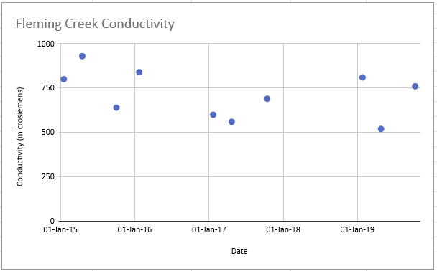
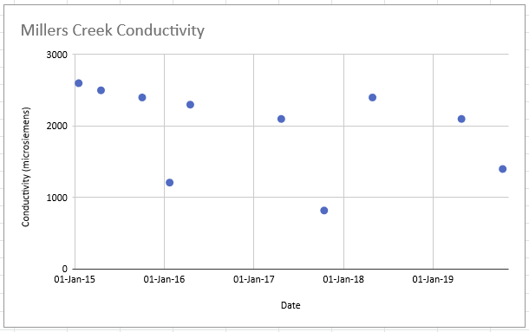
Conductivity
Conductivity levels in Fleming Creek are normal and have been normal since monitoring began in 1993.
Conductivity levels in Millers Creek are high and have been high since monitoring began in 1993. The east branch of Millers is particularly high in conductivity, often exceeding the already high levels of the main branch by 3 times.

Slide 24
Conductivity
How does conductivity impact the two creeks?
Type your claim here:
Type two pieces of evidence here:
Explain why the evidence supports your claim:
Notes:
Student page question 16
The research question is provided.
Develop and write a claim in the appropriate place in the graphic organizer. Conductivity indicates a root cause of the differences in Fleming and Millers Creek.
Identify two pieces of evidence from the data provided that support the claim and type them into the appropriate place.
The measured conductivity samples are higher in Millers Creek. The east branch of Millers is particularly high in conductivity, often exceeding the already high levels of the main branch by 3 times.
Write two bullet points describing the science that explains why the evidence supports the claim.
Conductivity can measure the presence of salt in the water. But more importantly it can indicate more impervious surfaces being salted. It’s the impervious surfaces that cause stream flashiness. And the presence of more impervious surfaces indicates more human activity, such as owning pets, creating litter, spilling oil etc, that affect the health of the creeksheds.

Slide 25
River Bugs
Which of the 3 parameters (TSS, DO, Conductivity) likely is impacting the river bugs in these 2 creeksheds?
Type your claim here:
Type two pieces of evidence here:
Explain why the evidence supports your claim:
Notes:
Student page question 17
This is the summary Claim/Evidence/Reasoning graphic organizer for you to use with your students as you choose. TSS can influence DO, and Conductivity is a measure that indicates the impacts of human density, which affects TSS and DO. So any combination of factors chosen by your students will probably be correct.

Slide 26
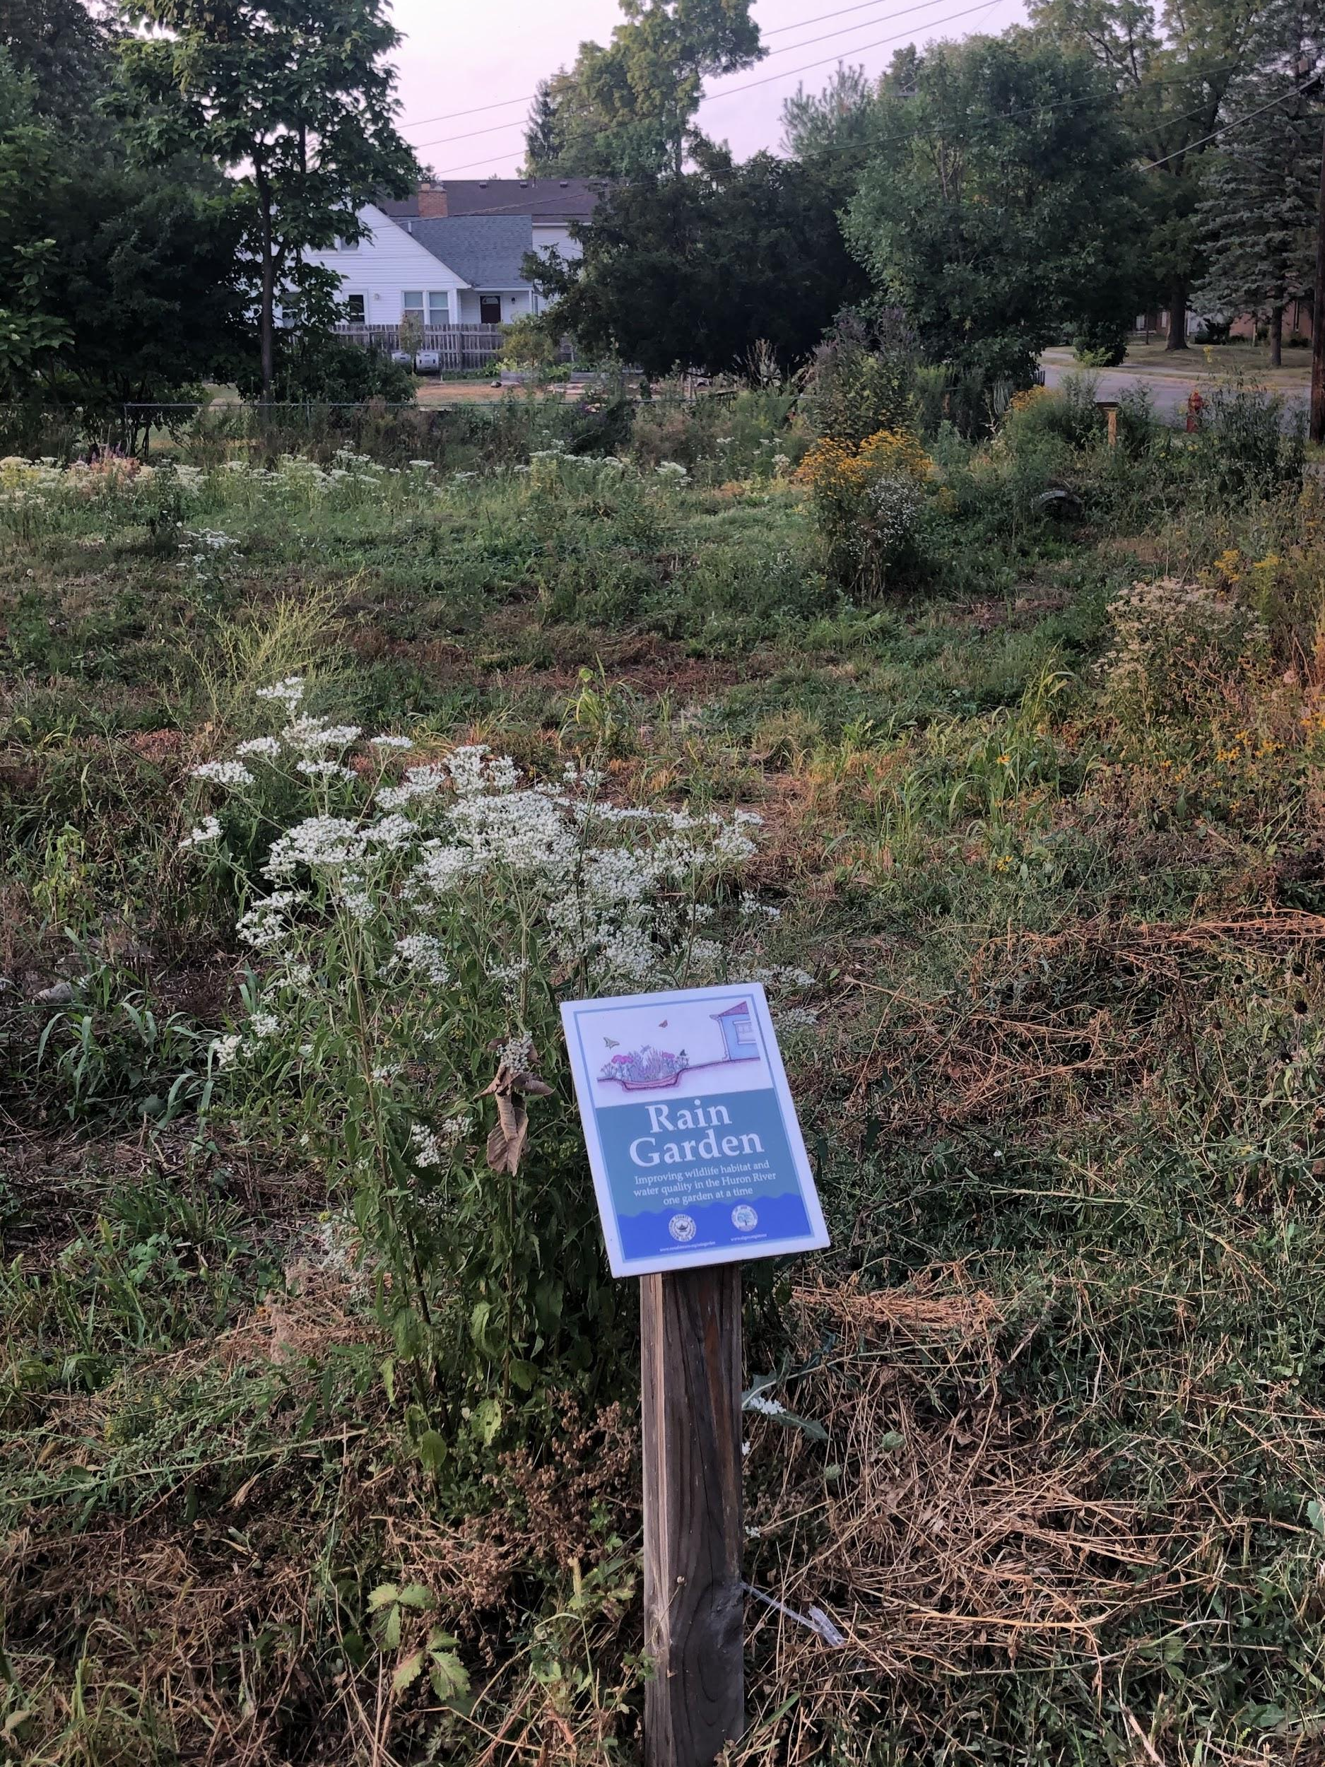
What can you do?
Plant a rain garden
Weed a rain garden
Remove litter from a rain garden

Slide 27
What can you do?
Bag the dog poop
(and put it in the trash)
Sweep the driveway,
instead of hosing it down.

Slide 28
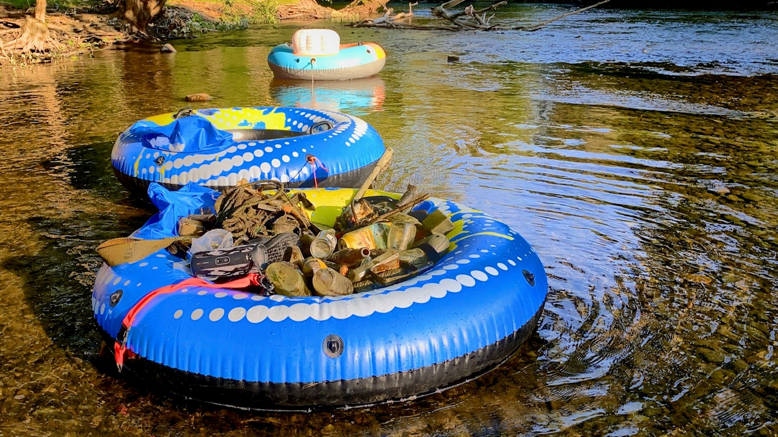
What can you do?
Join a river clean up

Slide 29
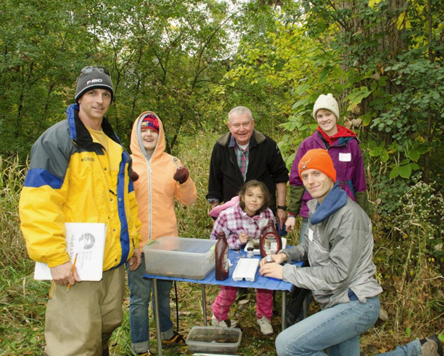
What can you do?
Volunteer with the Huron River Watershed Council

Slide 30
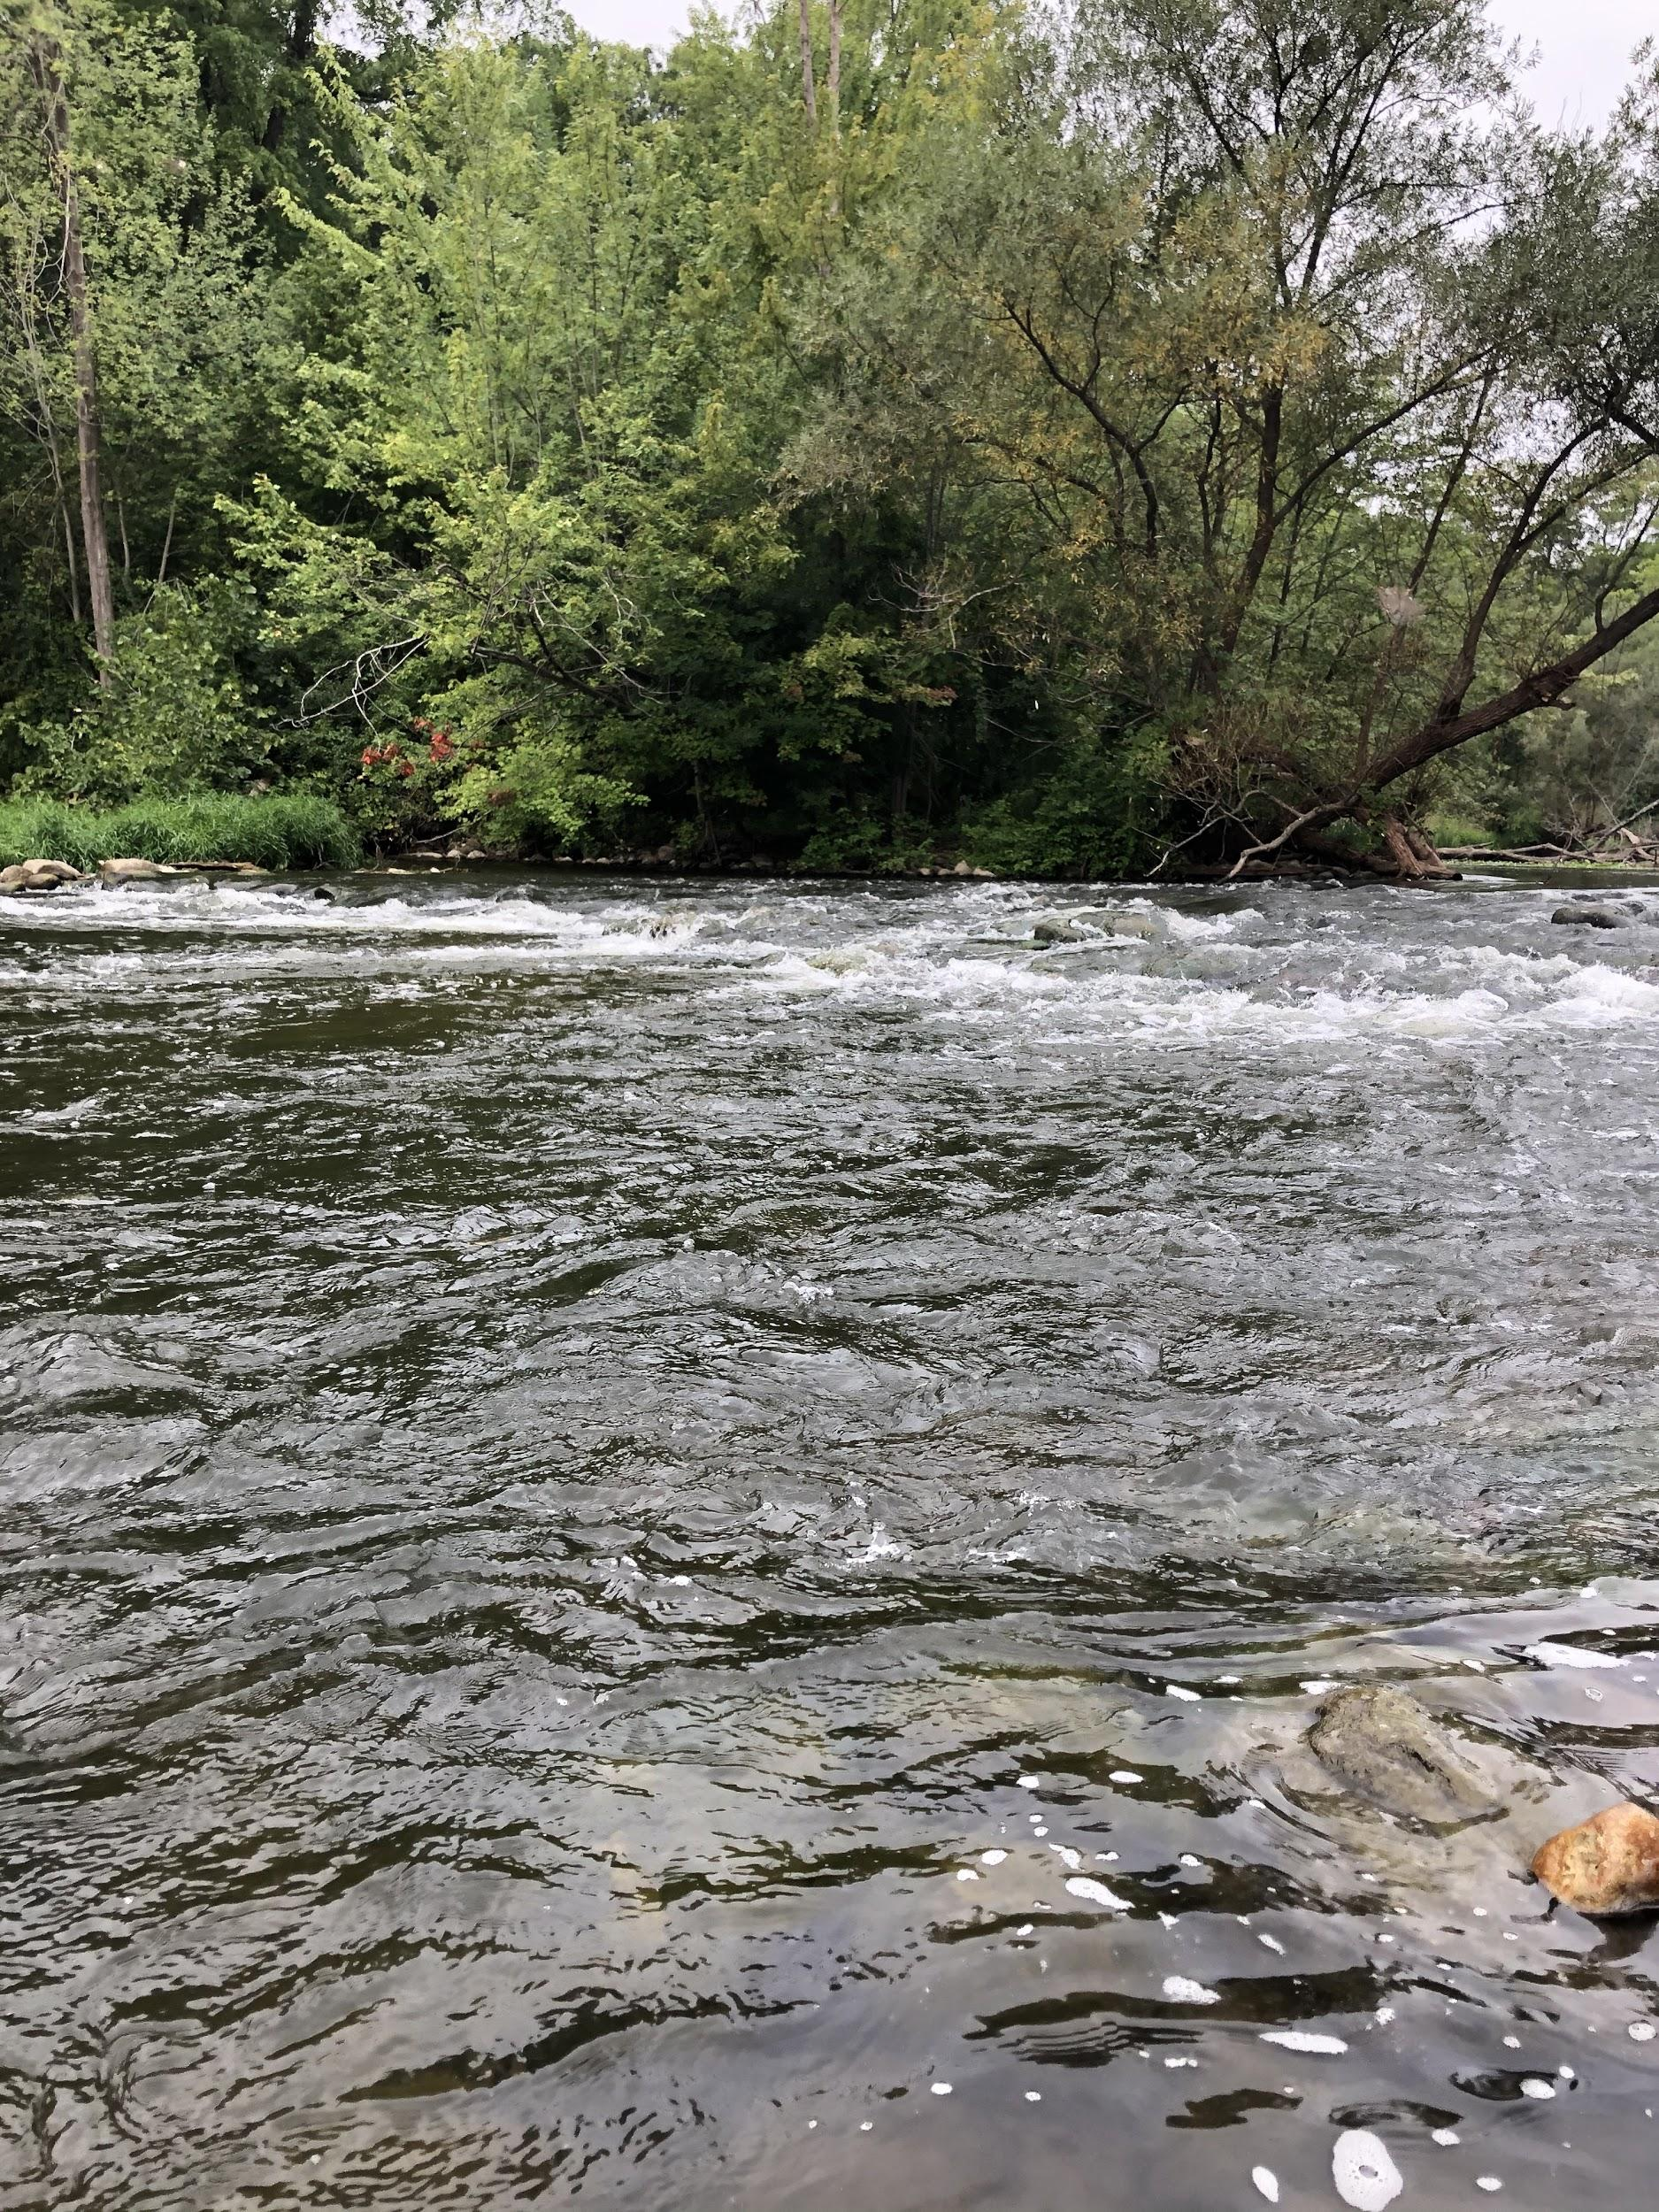
What will you do?
Notes:
Student page question 18 Choose one action you could actually take.
Tell where and when you could do it.
Tell how that will impact the watershed.

Slide 31
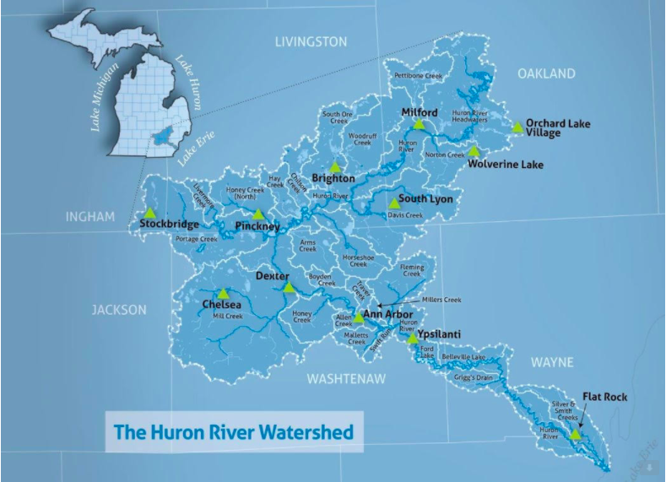
Notes:
The white triangles indicate where the two creeks are located in the watershed.

Slide 32
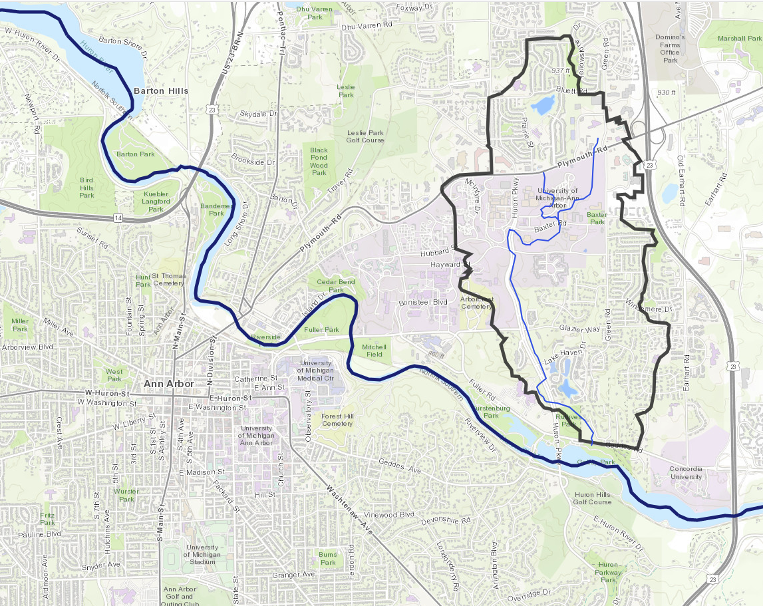
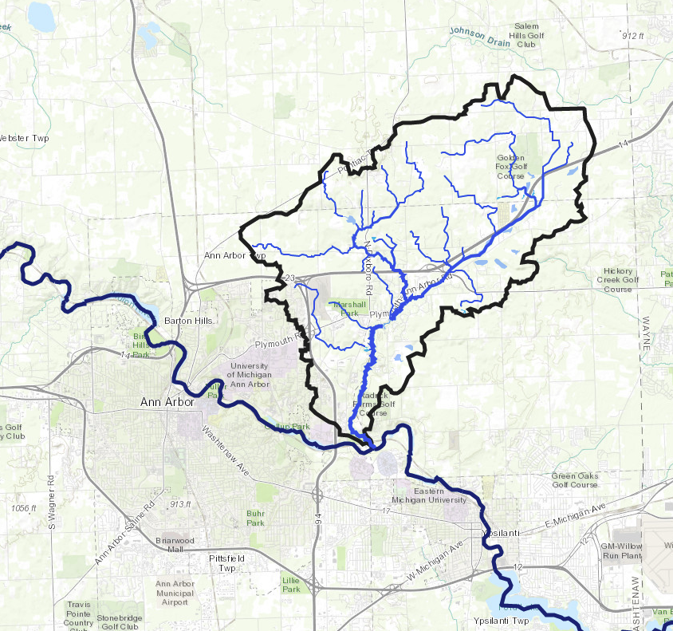
Fleming Creek
Millers Creek
Notes:
Slide with Miller and Fleming creek highlighted

