Slide 2
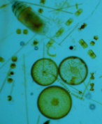
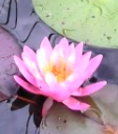
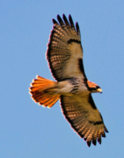
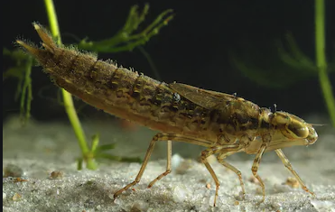
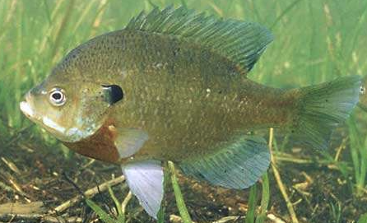
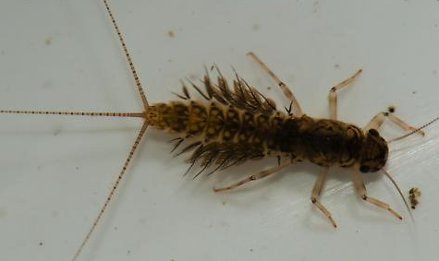
Initial Model
Photosynthesis
Respiration
Stream Flow
Sunlight
Temperature
Red Tailed Hawk
Water Lily
Mayfly larvae
Algae
Blue Gill
Dragonfly Larvae
Notes:
Protocol/Expectations/Insights:
Build this model to represent your group’s vision of the relationships between these system components
Model needs to include the basic food web and abiotic factors that influence - feel free to add more based on what you need
Adjust sizes, colors, fonts, etc... of any objects
Copy objects if needed
Hint: Use the “INSERT” tab and select “SHAPE” to find additional shapes and arrows to use

Slide 3
Initial Model
Photosynthesis
Respiration
Stream Flow
Sunlight
Temperature
Red Tailed Hawk
Water Lily
Mayfly larvae
Algae
Blue Gill
Dragonfly Larvae
Notes:
Protocol/Expectations/Insights:
Build this model to represent your group’s vision of the relationships between these system components
Model needs to include the basic food web and abiotic factors that influence - feel free to add more based on what you need
Adjust sizes, colors, fonts, etc... of any objects
Copy objects if needed
Hint: Use the “INSERT” tab and select “SHAPE” to find additional shapes and arrows to use

Slide 4
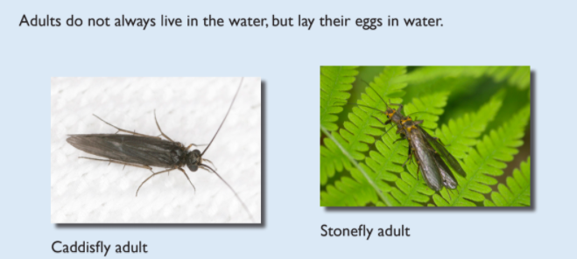
Benthic Macroinvertebrates are visible invertebrates in the water.
Notes:
Add Janet’s Video description of BMI

Slide 5
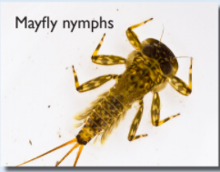
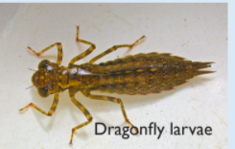
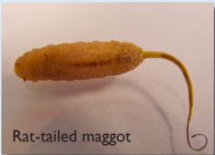
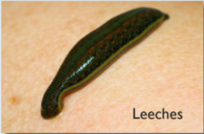

Slide 6
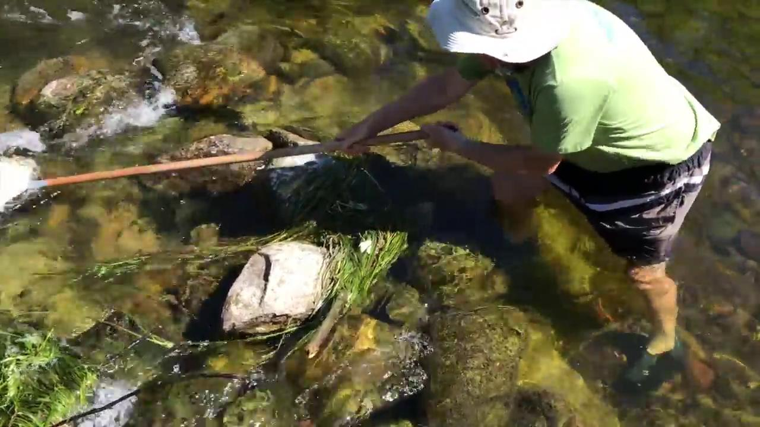
Here is a video to explain how invertebrate sampling is done.

Slide 7
What Makes a Healthy Creek?
A healthy creekshed has stable banks with a broad corridor of trees and shrubs, riffles free of silt deposition, fairly stable temperatures and a benthic population that includes a diverse variety of creatures, including several groups that are sensitive to organic pollution.
Aquatic Insect Community
The benthic population includes a diverse variety of creatures, including several groups that are sensitive to organic pollution.
The insect community in Millers Creek reflects the overall poor water quality, lack of habitat, and unstable stream flows that characterize the stream. The only creatures found in Millers are those that have the tenacity to endure harsh conditions, and therefore the overall diversity and abundance of the insect community is very low.
Overall, Fleming Creek has a very healthy insect community. The west branch is particularly diverse, being the second most diverse site in the Huron watershed after correcting for stream size. The upper east branch has more fine sediment, parts of it have been channelized, and as a result the aquatic insect community is not as abundant. The main branch is a logical combination of the two upper branches.

Slide 8
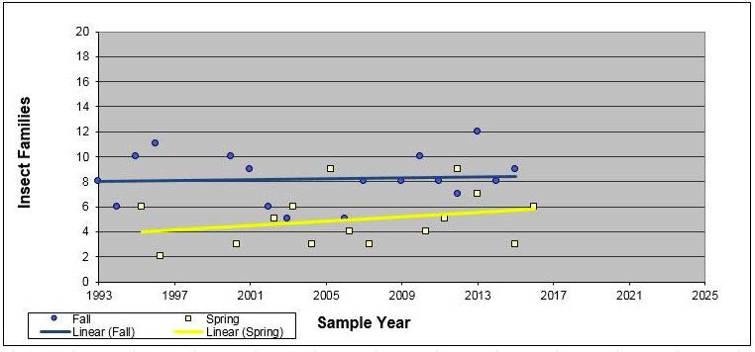
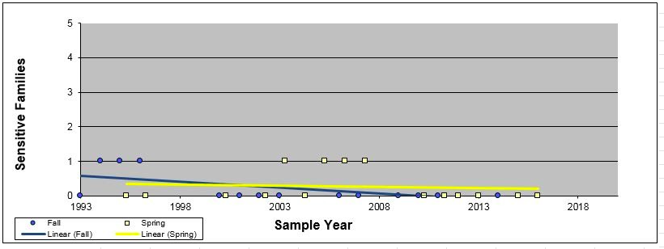
Aquatic Insects
Research Question: How does the diversity of aquatic insects affect the health of a watershed?
Fleming Creek-->
← Millers Creek

Slide 9
Aquatic Insects
Research Question: How does the diversity of aquatic insects affect the health of a watershed?
Model Revision:
Additional term(s) to add to model:
Using the additional terms and other shapes and symbols necessary, revise your initial model based on what you learned from the video, reading and data presented on the previous slides.
Invertebrates
Possible shapes to use:
Notes:
Return to the initial model you built
Now that you know a little more about your assigned variable, revise the model to reflect what you have learned.
You are required to add the term(s) on this slide.
The other shapes are for your model revision consideration. These are optional.

Slide 10
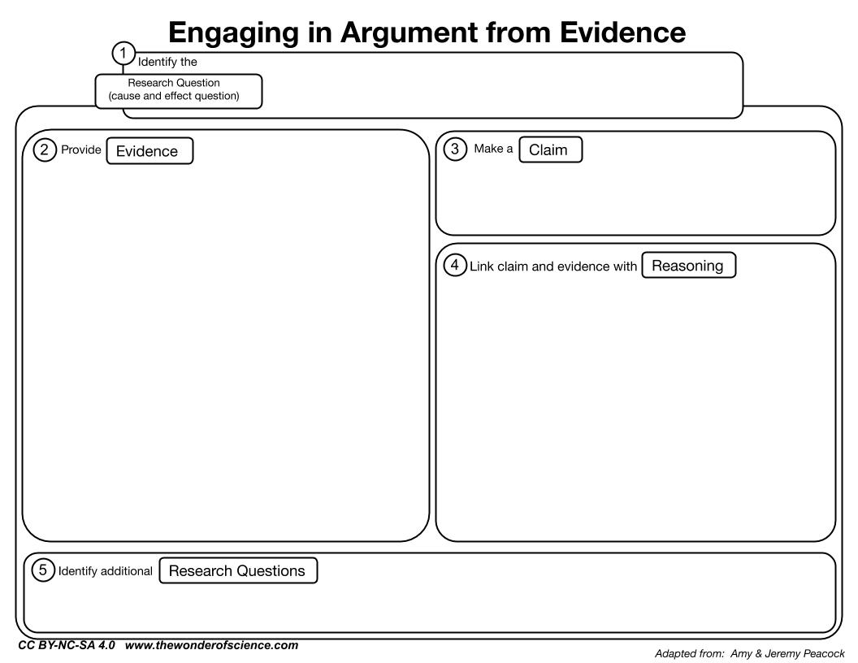
Aquatic Insects
Which creek is healthier in terms of aquatic insects?
Type your claim here
Type two pieces of evidence here
Predict or explain why the evidence supports the claim
Notes:
The research question is provided.
Develop and write a claim (one sentence answer to the research question) in the appropriate place in the graphic organizer.
Identify two pieces of evidence from the data provided that support the claim and type them into the appropriate place.
HINT: try to use quantitative data as part of the evidence
Write three bullet points describing the science that explains or predicts why the evidence supports the claim.
HINT: stay focused on the research question

