Slide 2
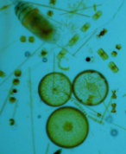
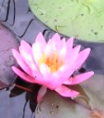
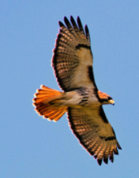
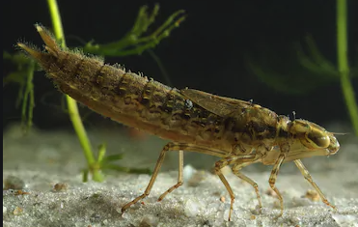
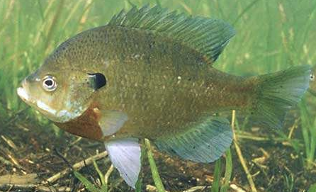
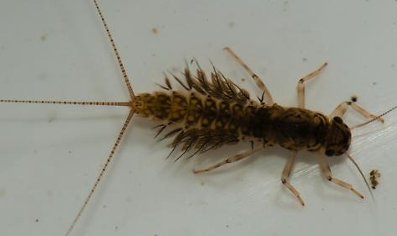
Initial Model
Photosynthesis
Respiration
Stream Flow
Sunlight
Temperature
Red Tailed Hawk
Water Lily
Mayfly larvae
Algae
Blue Gill
Dragonfly Larvae
Notes:
Protocol/Expectations/Insights:
Build this model to represent your group’s vision of the relationships between these system components
Model needs to include the basic food web and abiotic factors that influence - feel free to add more based on what you need
Adjust sizes, colors, fonts, etc... of any objects
Copy objects if needed
Hint: Use the “INSERT” tab and select “SHAPE” to find additional shapes and arrows to use

Slide 3
Stream discharge = the amount of water flowing past a set distance

Slide 5
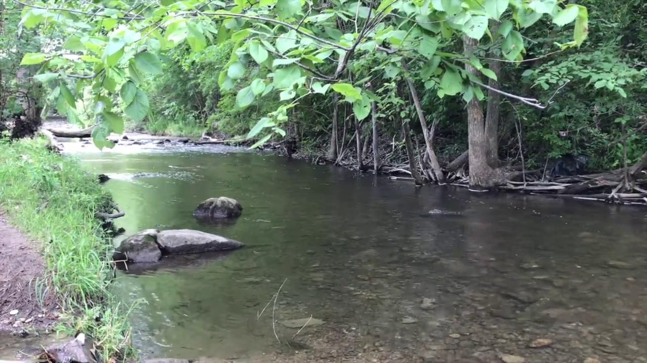

Slide 6
What Makes a Healthy Creek?
A healthy creekshed has stable banks with a broad corridor of trees and shrubs, riffles free of silt deposition, fairly stable temperatures and a benthic population that includes a diverse variety of creatures, including several groups that are sensitive to organic pollution.
Stream Flow
Stream flow is an important underlying factor for determining likely erosion rates, stream habitat quality, and aquatic community diversity. An important measure is “flashiness” or the rate a stream rises and falls through a storm event.
In Millers Creek high stream flows after storms still cause massive erosion and destroy habitat. While there have been improvements in recent years, the problem is not yet solved. In particular some of the smaller tributaries are downcutting and eroding at very high rates.
Fleming Creek has a flashiness rating that is high for comparable Michigan streams, but average for the Midwest.

Slide 7
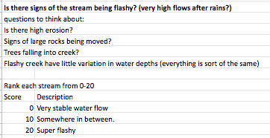
Data for the discharge of Millers and Fleming Creeks

Slide 8
Stream Discharge
Research Question: How does stream discharge affect the health of a watershed?
Model Revision:
Using the additional terms and other shapes and symbols necessary, revise your initial model based on what you learned from the video, reading and data presented on the previous slides.
Additional term(s) to add to model:
Flashiness
Possible shapes to use:
Notes:
Return to the initial model you built
Now that you know a little more about your assigned variable, revise the model to reflect what you have learned.
You are required to add the term(s) on this slide.
The other shapes are for your model revision consideration. These are optional.

Slide 9
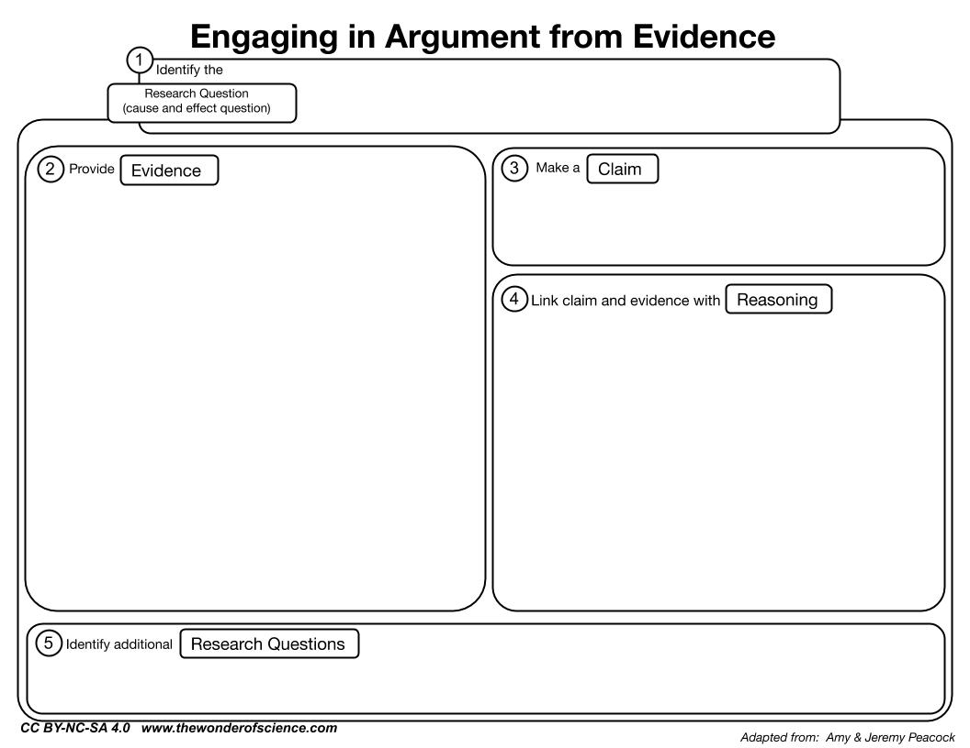
Stream Discharge
Which creek is healthier in terms of stream discharge?
Type your claim here
Type two pieces of evidence here
Predict or explain why the evidence supports the claim
Notes:
The research question is provided.
Develop and write a claim (one sentence answer to the research question) in the appropriate place in the graphic organizer.
Identify two pieces of evidence from the data provided that support the claim and type them into the appropriate place.
HINT: try to use quantitative data as part of the evidence
Write three bullet points describing the science that explains or predicts why the evidence supports the claim.
HINT: stay focused on the research question

