Slide 2
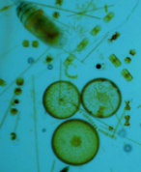
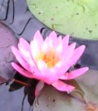
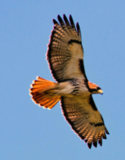
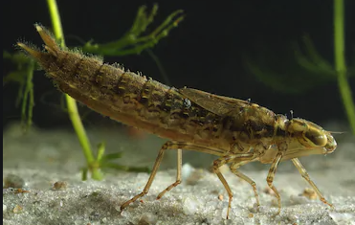
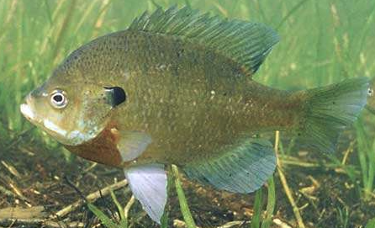
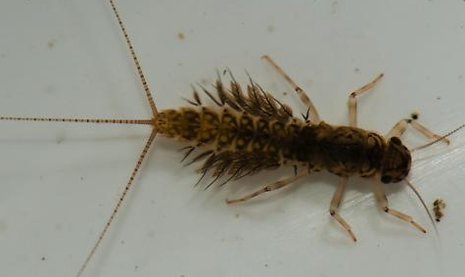
Initial Model
Photosynthesis
Respiration
Stream Flow
Sunlight
Temperature
Red Tailed Hawk
Water Lily
Mayfly larvae
Algae
Blue Gill
Dragonfly Larvae
Notes:
Protocol/Expectations/Insights:
Build this model to represent your group’s vision of the relationships between these system components
Model needs to include the basic food web and abiotic factors that influence - feel free to add more based on what you need
Adjust sizes, colors, fonts, etc... of any objects
Copy objects if needed
Hint: Use the “INSERT” tab and select “SHAPE” to find additional shapes and arrows to use

Slide 3
Background- Temp and TSS
Temperature
Notes:
Add Janet’s Video description of BMI

Slide 6
Watch video for more information on how temperature affects the river

Slide 7
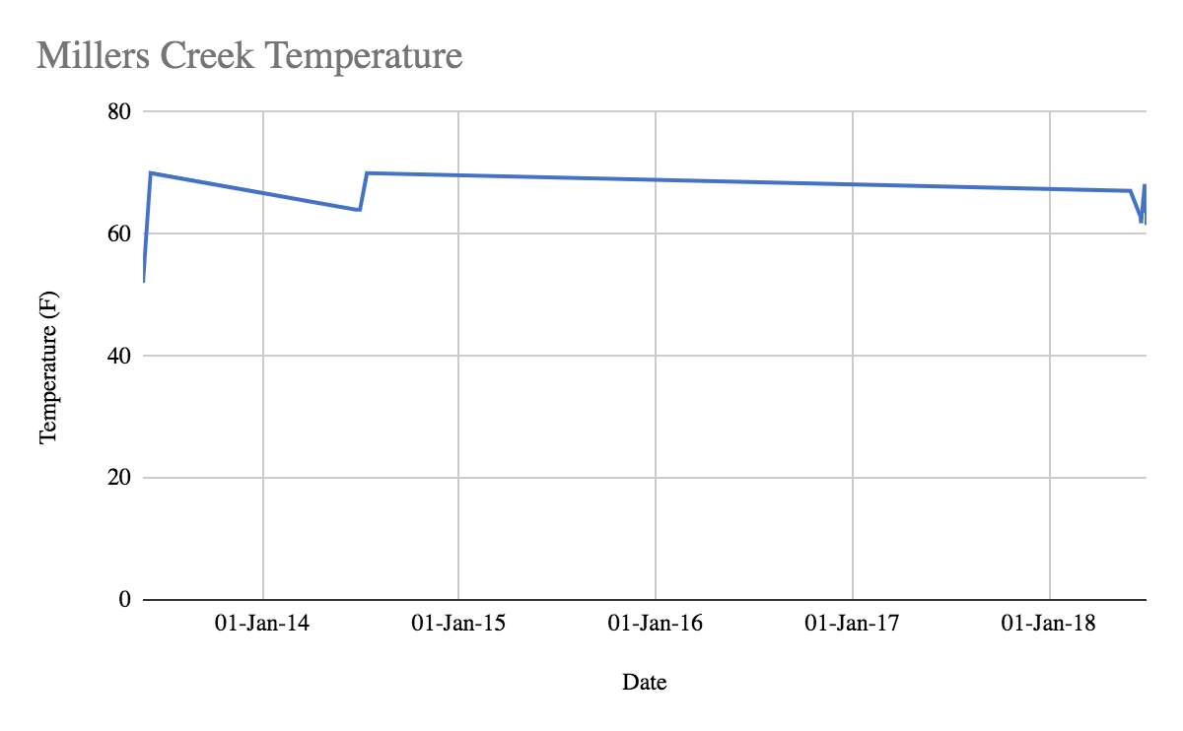
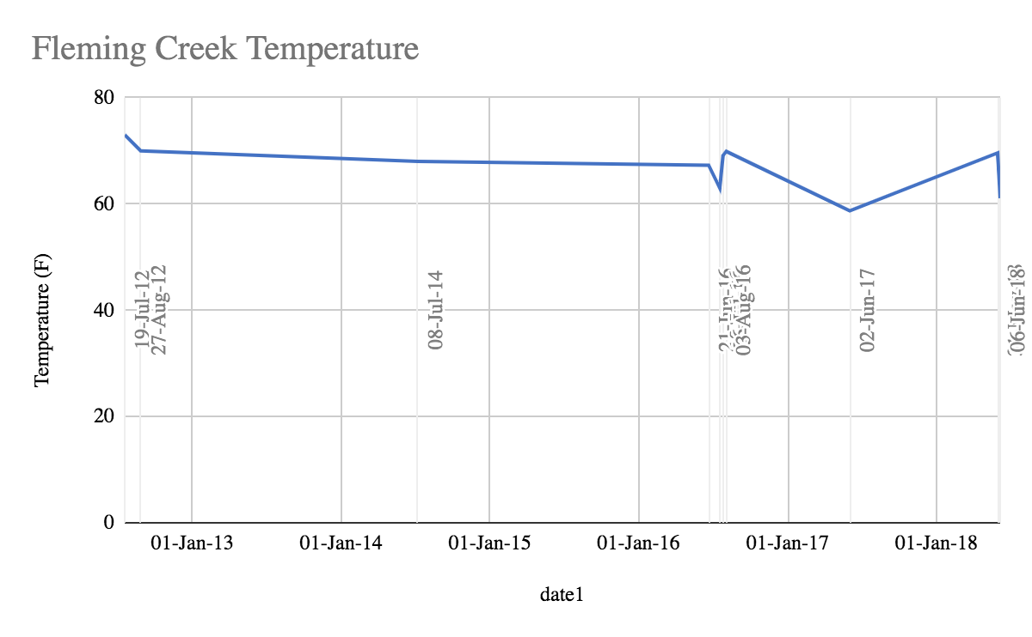
Comparison of two creeks
Research Question: How does the temperature affect the health of a watershed?

Slide 8
What Makes a Healthy Creek?
A healthy creekshed has stable banks with a broad corridor of trees and shrubs, riffles free of silt deposition, fairly stable temperatures and a benthic population that includes a diverse variety of creatures, including several groups that are sensitive to organic pollution.
Stream Water Temperature
Temperature measurements that rarely get above 71°F and rarely drop below 60 °F during July and August are a normal water temperature range for a creek in this area of Michigan.
Millers Creek receives a constant trickle of cold groundwater, and vegetation shades much of the stream. When the stream is flowing low, the water temperature can get as cold as 55°F during July and August. After rain events, warmer surface water enters the creek and can raise the temperature up to 75°F, which is obviously quite a bit higher, but is still a healthy summer temperature.
Fleming Creek receives a mix of cold ground water and warmer surface runoff. Much of the stream is shaded by natural riparian areas. Temperature measurements show that the water temperature of Fleming Creek rarely gets above 70°F and rarely drops below 60 °F during July and August. This is a normal water temperature for a creek with these properties and in this area of Michigan.

Slide 9
Temperature
Research Question: How does the affect temperature the health of a watershed?
Model Revision:
Using the additional terms and other shapes and symbols necessary, revise your initial model based on what you learned from the video, reading and data presented on the previous slides.
Additional term(s) to add to model:
Temperature
Depth of Water
Possible shapes to use:
Notes:
Return to the initial model you built
Now that you know a little more about your assigned variable, revise the model to reflect what you have learned.
You are required to add the term(s) on this slide.
The other shapes are for your model revision consideration. These are optional.

Slide 10
Temperature
Which creek is healthier in terms of temperature?
Type your claim here
Type two pieces of evidence here
Predict or explain why the evidence supports the claim
Notes:
The research question is provided.
Develop and write a claim (one sentence answer to the research question) in the appropriate place in the graphic organizer.
Identify two pieces of evidence from the data provided that support the claim and type them into the appropriate place.
HINT: try to use quantitative data as part of the evidence
Write three bullet points describing the science that explains or predicts why the evidence supports the claim.
HINT: stay focused on the research question

