Slide 2
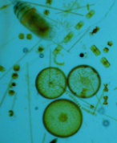
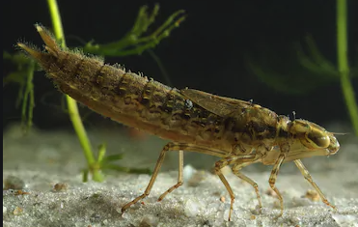
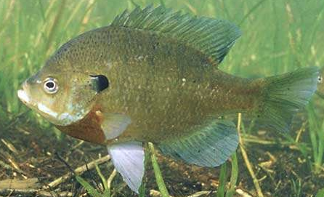
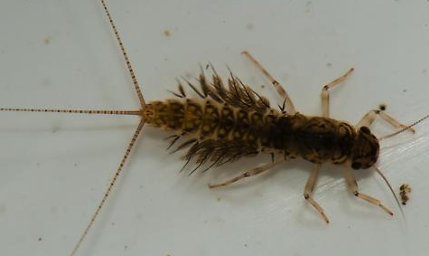
Initial Model
Photosynthesis
Respiration
Stream Flow
Sunlight
Temperature
Red Tailed Hawk
Water Lily
Mayfly larvae
Algae
Blue Gill
Dragonfly Larvae
Notes:
Protocol/Expectations/Insights:
Build this model to represent your group’s vision of the relationships between these system components
Model needs to include the basic food web and abiotic factors that influence - feel free to add more based on what you need
Adjust sizes, colors, fonts, etc... of any objects
Copy objects if needed
Hint: Use the “INSERT” tab and select “SHAPE” to find additional shapes and arrows to use

Slide 3
Turbidity = dirt in the water

Slide 6
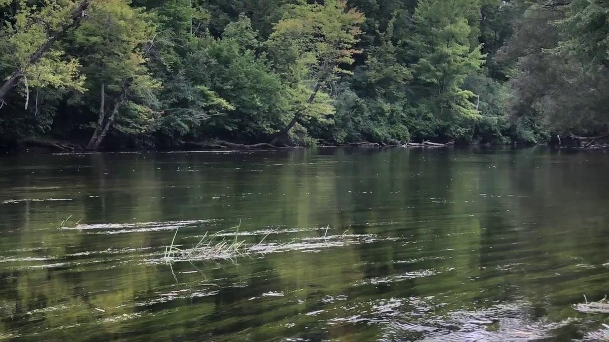

Slide 7
What Makes a Healthy Creek?
A healthy creekshed has stable banks with a broad corridor of trees and shrubs, riffles free of silt deposition, fairly stable temperatures and a benthic population that includes a diverse variety of creatures, including several groups that are sensitive to organic pollution.
Total Suspended Solids
Total suspended solids (TSS) is a measurement of the amount of material held by the stream. A high TSS indicates high turbidity and erosion problems. Good TSS values are below 80 mg/l.
Millers Creek’s mean TSS is 16 mg/l, although during high flow TSS levels can reach up to 154 mg/l.
Fleming Creek’s mean TSS is 41 mg/l.

Slide 8
Turbidity
Research Question: How does turbidity affect the health of a watershed?
Total suspended solids concentrations at Fleming Creek also illustrate no observable trend. Average TSS concentrations at Fleming Creek from 2010 to 2019 are 25.6 mg/l (s=97.1) with a median of 6.4 mg/l. Both concentrations report below the 80 mg/l threshold, with only 4 samples during the 10-year period exceeding that standard.
Standard:
Total suspended solids (TSS) is a measurement of the amount of material held by the stream. A high TSS indicates high turbidity and erosion problems. Good TSS values are below 80 mg/l.
MH08: Total suspended solids concentrations at Millers Creek ranged from 0.80 mg/l to 256 mg/l over the span of the most recent ten years. During this period, both mean and median TSS values of 18.33 mg/l (s=33.7) and 7.2 mg/l respectively are below the state standard of 80 mg/l. Only five samples out of 120 during the ten-year period exceeded the state standard, despite Millers Creek being one of the more severely eroded creeks in the Middle Huron. These concentrations over 80 mg/l occur during or following significant storm or bankfull events. No statistically significant trend in TSS is apparent at Millers Creek as most data varies annually.

Slide 9
Turbidity
Research Question: How does turbidity affect the health of a watershed?
Model Revision:
Using the additional terms and other shapes and symbols necessary, revise your initial model based on what you learned from the video, reading and data presented on the previous slides.
Additional term(s) to add to model:
Amount of dirt
Possible shapes to use:
Notes:
Return to the initial model you built
Now that you know a little more about your assigned variable, revise the model to reflect what you have learned.
You are required to add the term(s) on this slide.
The other shapes are for your model revision consideration. These are optional.

Slide 10
Turbidity
Which creek is healthier in terms of turbidity?
Type your claim here
Type two pieces of evidence here
Predict or explain why the evidence supports the claim
Notes:
The research question is provided.
Develop and write a claim (one sentence answer to the research question) in the appropriate place in the graphic organizer.
Identify two pieces of evidence from the data provided that support the claim and type them into the appropriate place.
HINT: try to use quantitative data as part of the evidence
Write three bullet points describing the science that explains or predicts why the evidence supports the claim.
HINT: stay focused on the research question

